Slide 1

Evaluating Speech-to-Speech Translation for Dubbing: Challenges and New Metrics
Fred Bane, Celia Soler Uguet, Llorenç Suau,
João Torres, and Alan Vivares
TransPerfect AI

Slide 2
agenda
Translation of speech vs. text
Dubbing and Voice Over (V.O.)
New developments in speech translation
Existing evaluation methods
What should we be evaluating?
Pilot evaluation results

Slide 3

Text vs Speech translation
Differences in the translation of text and speech.

Slide 4
Working with Speech vs. text
Text | Speech
Discrete input | Continuous input
Singular signal | Mixed signals
Time-independent | Time-dependent
Linguistic evaluation | Linguistic + Voice evaluation
Less information overall | More information overall
Compact representation | Larger representation

Slide 5
Dubbing and voice-over
Key differences with other applications of speech translation
Timing: Must fit in the same time span as the original
Synchronization: In dubbing, synchronization of the voice with the lip movements is critical
Emotional expressivity: In dubbing, matching the emotional content of the voice to the situation is critical
Fidelity: Natural speech content that does not break immersivity is more important than maintaining fidelity
Character appropriateness: The voice, speech content, and expressivity must be appropriate for the character

Slide 6

speech-speech translation is entering a new era

Slide 7
The development of AI-driven translation
1990
1999
2014
2019
Early Development
The Rise of Neural Networks
1990s: The concept of machine translation (MT) began to gain traction, with early models focusing primarily on text-based translations.
1999: Early S2S translation system introduced by the C-STAR-2 Consortium. By 2003, similar systems were developed for handheld devices.
2014: Microsoft introduced (cascade-based) speech translation in Skype. Around the same time, Google launched Neural Machine Translation (NMT),
2019: Google introduced Translatotron, the first end-to-end model that directly translated speech from one language to another, bypassing text altogether.

Slide 8
The development of AI-driven translation
2021
2023
2024
🚀
Recent Advancements
Future Trends
2021: Meta introduced SeamlessM4T, a multilingual and multimodal model capable of both text-to-text and speech-to-speech translation.
2023: Translatotron, Meta's SeamlessM4T and others continued to evolve, covering more languages, and improving emotional expressivity
The future of AI in translation is expected to see further advancements in real-time translation capabilities across multiple modalities, particularly in enhancing the translation of low resource languages and incorporating non-verbal communication cues. LLMs have started to roll out voice capabilities, but audio is still separate from visual input.

Slide 9

Existing evaluation methods

Slide 10

Translation Evaluation is still text-based
ASR-BLEU: Transcribing the speech using ASR and calculating BLEU, a text-based measure of similarity
Dependent on the quality of the ASR system
Not robust to dialectal variations or non-standardized orthographies
Falls short in low-resource languages
BLEU has long been considered a poor metric for text translation, it is even less adequate for speech
Notes:
Translatotron2, Translatotron3, End-to-end Speech Translation via Cross-modal Progressive Training, LLaST Improved End-to-end Speech Translation System Leveraged by Large Language Models, Recent Advances in End-to-End Simultaneous Speech Translation, Textless Speech-to-Speech Translation on Real Data,

Slide 11
Voice quality Is evaluated manually
Most major papers use Mean Opinion Score (MOS) as the only way of measuring voice quality.
The Seamless Expressive paper is a welcome exception: automated tools for sentence-level prosody similarity, and a rhythm evaluation toolkit

Slide 12

Alternative evaluation methods
What should we be evaluating?

Slide 13
Voice
Linguistic
Intelligibility
Voice quality
Articulation, fluency, projection
Appropriateness
Suitability for character, cultural appropriateness
Expressivity
Emotional content, consistency with context
Timing (task specific)
Duration, lip synchronization
Accuracy
Mistranslation, over/under-translation, addition, omission, untranslated
Style
Organizational, language register, consistency
Terminology
Wrong term, consistency
Linguistic Conventions
Grammar, word form, part of speech, tense, agreement, word order
Locale Conventions

Slide 14
Voice - Quality
Articulation
Phoneme Error Rate (PER):
Quantifies the accuracy of phoneme production by comparing expected vs. actual phonemes. This is useful for identifying pronunciation issues.
Mel cepstral distortion
Formant Analysis:
Analyzes the resonant frequencies (formants) of the vocal tract, particularly crucial for vowel sounds. Deviations from expected formant values can indicate articulation issues.
Projection
Similarity of amplitude envelope features (inspired by Cummings et al. 1999)
Notes:
Articulation
Phoneme Error Rate (PER):
Definition: Quantifies the accuracy of phoneme production by comparing expected vs. actual phonemes (similar to F1 phoneme)
Method: Encodes voice into phonemes, then calculate PER to identify wrong phonemes. This metric is good for detecting pronunciation issues
Formant Analysis:
Definition: Analyzes the resonant frequencies (formants) of the vocal tract, particularly crucial for vowel sounds
Method: Use tool such as Praat to measure and compare formant frequencies (F1, F2, etc.) with expected values, detecting deviations that indicate articulation issues

Slide 15
Voice - Quality
Fluency
Perplexity of vocal path through frequency-time space
Transform the voice into frequency-time space, fit Bezier curves to the resulting path, calculate perplexity compared with a dataset of natural speech
Rhythmic analysis
Speech rate (Librosa, AutoPCP), pauses (Praat, pydub, Rhtyhm Toolkit)
F0 contour and amplitude envelope (Cummins et al., 1999)
Voice - Intelligibility
Perplexity of audio -> phoneme decoder
Notes:
Articulation
Phoneme Error Rate (PER):
Definition: Quantifies the accuracy of phoneme production by comparing expected vs. actual phonemes (similar to F1 phoneme)
Method: Encodes voice into phonemes, then calculate PER to identify wrong phonemes. This metric is good for detecting pronunciation issues
Formant Analysis:
Definition: Analyzes the resonant frequencies (formants) of the vocal tract, particularly crucial for vowel sounds
Method: Use tool such as Praat to measure and compare formant frequencies (F1, F2, etc.) with expected values, detecting deviations that indicate articulation issues

Slide 16
Voice - Appropriateness
Mel frequency cepstral coefficient similarity
Cosine distance embedding vectors (x-vectors, PnG NAT TTS model in Nobuyuki et al., 2022)
Automated MOS prediction (MOSnet in Lo et al. 2019)
Classifier trained to predict if the voice is the same
Voice - Expressivity
Prosody similarity (AutoPCP)
Emotion detection systems
Notes:
Articulation
Phoneme Error Rate (PER):
Definition: Quantifies the accuracy of phoneme production by comparing expected vs. actual phonemes (similar to F1 phoneme)
Method: Encodes voice into phonemes, then calculate PER to identify wrong phonemes. This metric is good for detecting pronunciation issues
Formant Analysis:
Definition: Analyzes the resonant frequencies (formants) of the vocal tract, particularly crucial for vowel sounds
Method: Use tool such as Praat to measure and compare formant frequencies (F1, F2, etc.) with expected values, detecting deviations that indicate articulation issues

Slide 17
Linguistic – accuracy
Encoder embedding similarity (BLASER - Bilingual and Language-Agnostic Speech Evaluation by Retrieval)
Round-trip phoneme F1
Back-translating the output translation into the source language and comparing the two audios represented as sequences of phonemes
Round-trip BLASER
BLASER may capture semantic features, in a way that COMET can augment chrF1/BLEU scores for text translation
Notes:
BLASER:
Multilingual, multimodal evaluation framework, that evaluates translation quality using supervised human-annotated data.
Directly encodes the speech of the source and target segments in a shared embedding space and computes the translation quality score.

Slide 18
Linguistic – style
???
Linguistic – terminology
???????
linguistic/locale conventions
???????????
There is still a long way to go ☺

Slide 19
Pilot evaluation results
Results from a small-scale pilot, reviewed manually with the error taxonomy shown previously

Slide 20
Pilot setup
Short clips from movies, web series, and documentaries, showcasing a variety of expressive conditions;
We first separated speech signals from background noise in the audio track;
Then we translated each vocal track into FR and ES using Seamless Expressive and a cascade approach (whisper ➔ internally trained MT models ➔ internally developed TTS models);
Next, translated audio was reinserted into the background noise at the corresponding time using the time codes of the speech signals;
Reviewers worked on the DataForce platform to annotate errors, indicating the type, severity, start time, and end time of each error.

Slide 21
Errors by model, type, severity

Slide 22
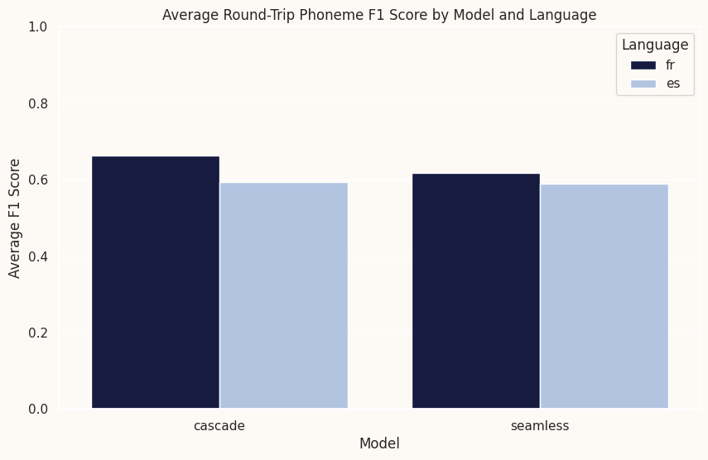
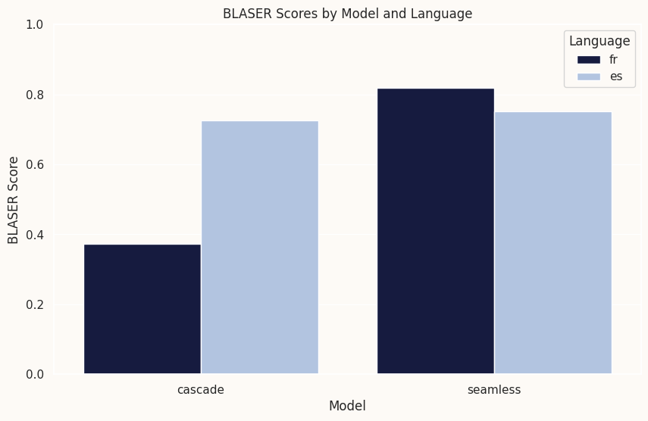
Pilot results vs BLASER
Round-Trip Phoneme F1 scores exhibit a similar trend to BLASER. However, French translations using the Cascade model received much lower BLASER scores, possibly due to differences in vocal rather than linguistic characteristics of the translations

Slide 23
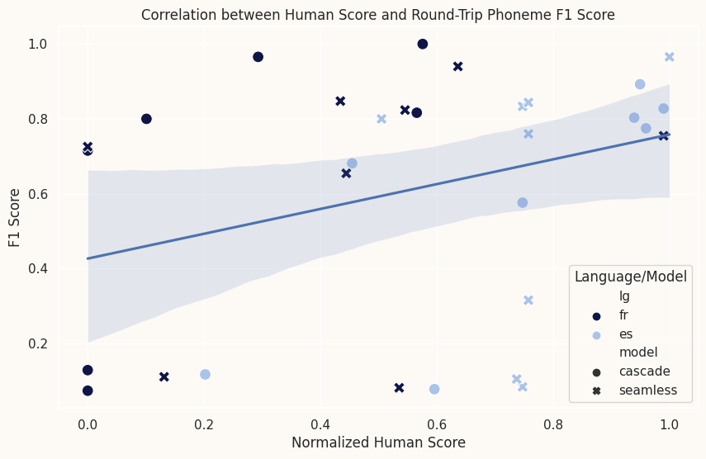
Correlation Between Human Evaluation and pilot Scores
We normalized the Human Evaluation Scores to a scale between 0 and 1, with 1 representing a perfect, error-free translation. This normalization allowed us to benchmark the Round-Trip Phoneme F1 Score against human judgment;
Although the positive slope indicates that higher human scores generally align with better F1 scores, the correlation is not statistically significant.
Notes:
Positive Correlation: An upward regression slope indicates that higher human evaluations generally correspond with better F1 scores, although the correlation is moderate.
Variability and Outliers: Significant scatter and outliers suggest that factors beyond human scores influence F1 outcomes.
Next Steps:
Quantify Correlation: Calculate the Pearson coefficient to measure the exact strength of the correlation.
Analyze Outliers: Examine anomalies to understand disparities between model performance and human judgment.
Expand Analysis: Include additional variables to deepen insights into the factors affecting F1 scores.

Slide 24

Thank you
Fred Bane
fbane@translations.com
github.com/TransperfectAI/amta2024_S2SEvaluation

